Slide 1
Rule Based ChatBot Using NLP
Data Practicum Project
By Sharadha S (Shar)

Slide 2
Outline
The Situation
Problem Statement
The Solution
The Data
Methodology
Results
Conclusion

Slide 3
The Situation
Opening a new bank account can be difficult. We have so many questions that come up.. How do I access my account online? How do I deposit cash? What is power of attorney? Etc…
These questions often don’t come to us all at once. Waiting on line to talk to customer service each time we have a doubt is quite a hassle!
The information available on the websites as well are spread out and it takes time to find what we are looking for.

Slide 4
Problem Statement
Is there a quick and efficient way to have our banking FAQs answered?
Is there a better way to have our questions answered - without waiting on a call for customer service or having to search through google and a bank’s website ?
A method that saves time and answers our questions accurately.

Slide 5
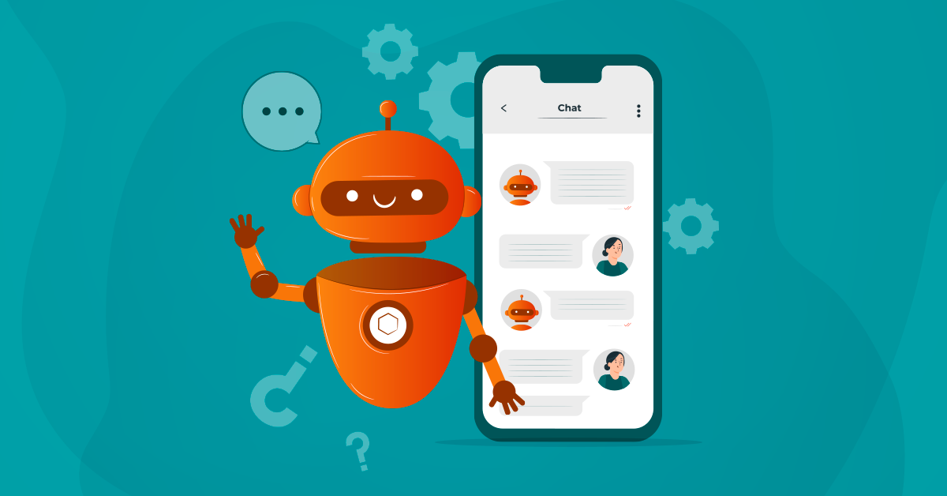
The Solution
A Rule-Based ChatBot
A Chatbot that takes in the user’s questions, and gives them relevant information in a matter of seconds
A Rule-Based ChatBot uses NLP or Natural Language Processing
Why Rule-Based ChatBot rather than using AI?
Less computing time
Less computing power
Straightforward applications that don’t require relearning, only fetching information

Slide 6
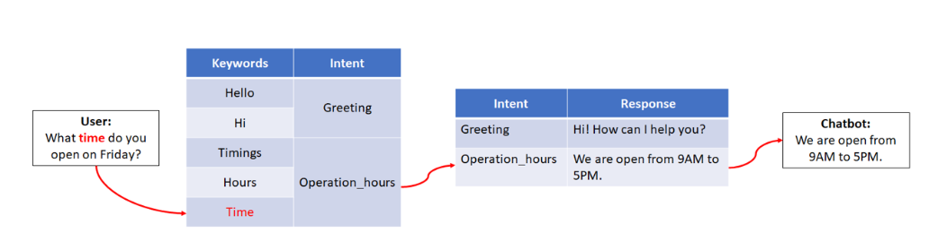
What is a Rule-Based ChatBot?

Slide 7
The Data

Slide 8
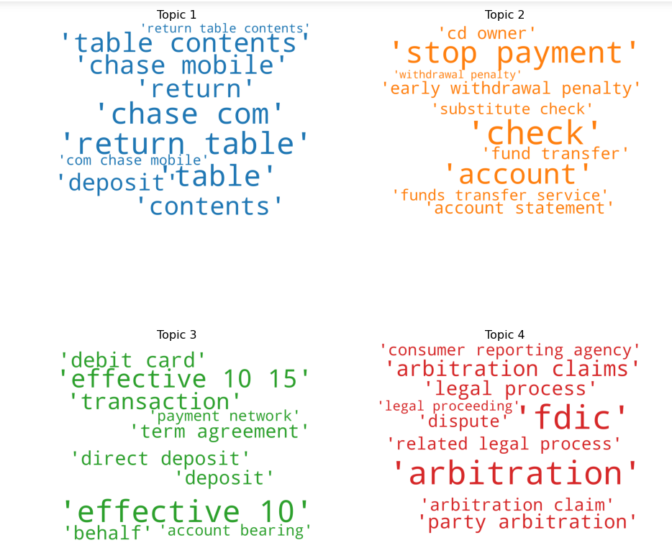
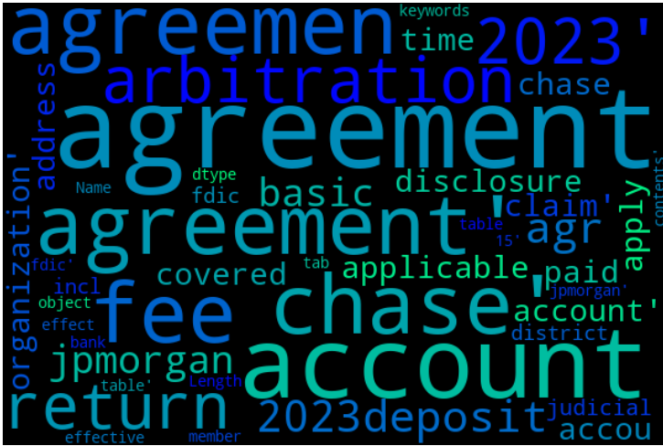
I will be using data from Chase Bank.
For initial protocol - I will be working with the deposit account agreement and privacy notice file obtained from Chase bank website.
Working with PDF - Makes sure project is dynamic and will work for all future applications
Why? Full length information files are usually hard to find. It required a lot of searching to get the required information.

Slide 9
Methodology

Slide 10
Methodology
Data Wrangling
Text Analytics
Text Analytics
Text Analytics
Coding (Algorithms)
Enhancement
Integration
Gather and Clean data
Perform NLP on data
Intent (keyword) extraction algorithm on data
Keyword extraction algorithm for user input
Keyword to Intent Matching Algorithm
Text Highlighting mechanism
Integration and Front-end

Slide 11
Results - Final Product
The ChatBot
The Highlight feature

Slide 12
The ChatBot
(using Gradio Chatbot UI)

Slide 13
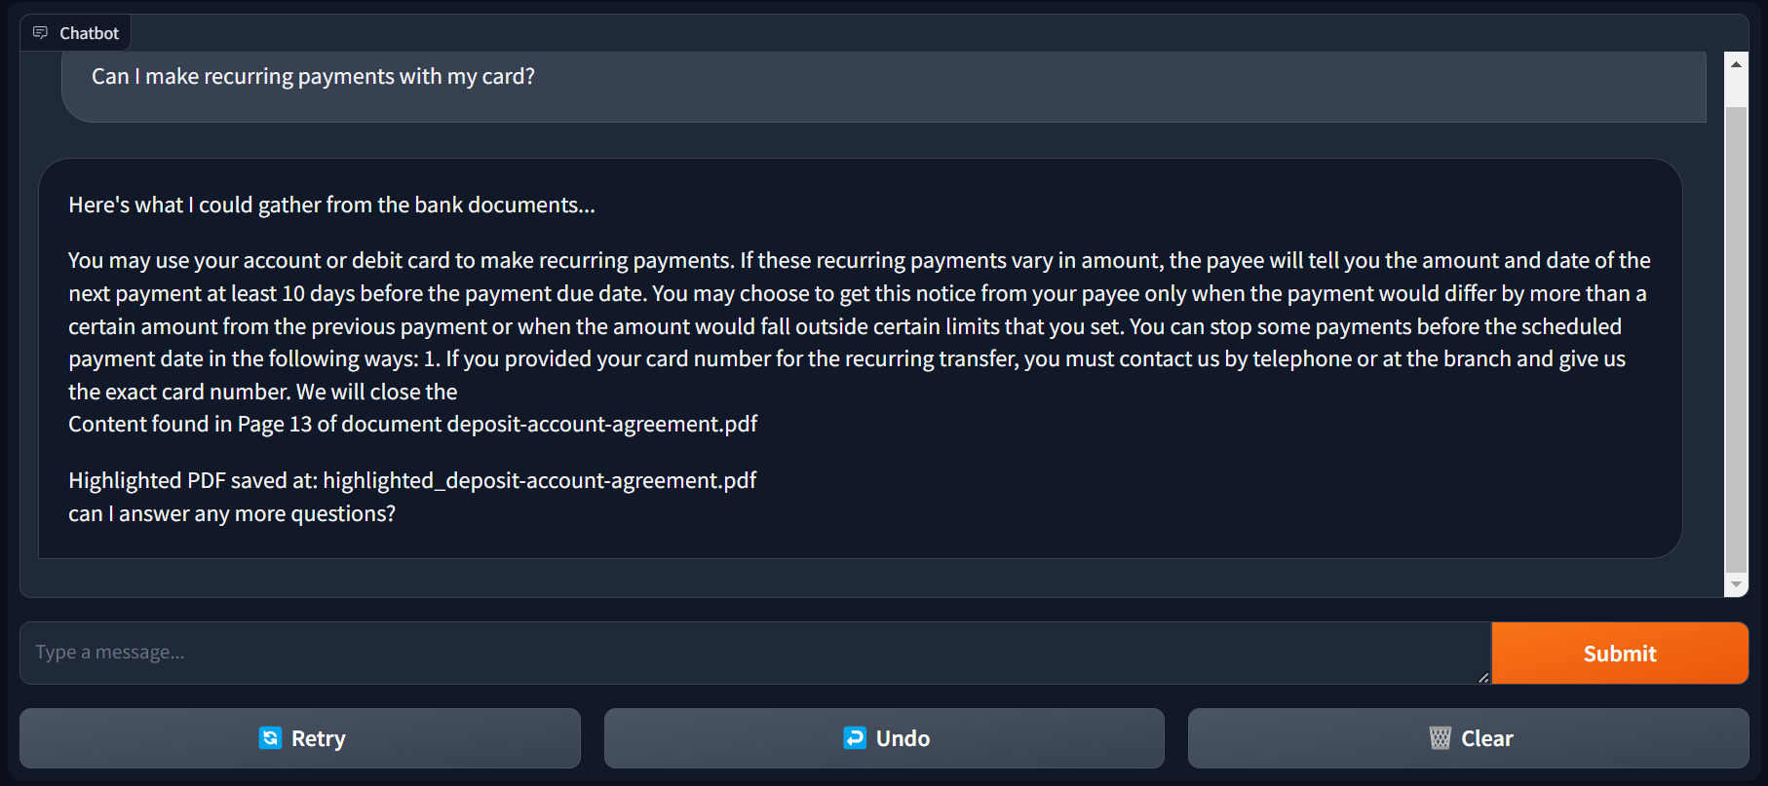

Slide 14
2. The Highlight Feature

Slide 15
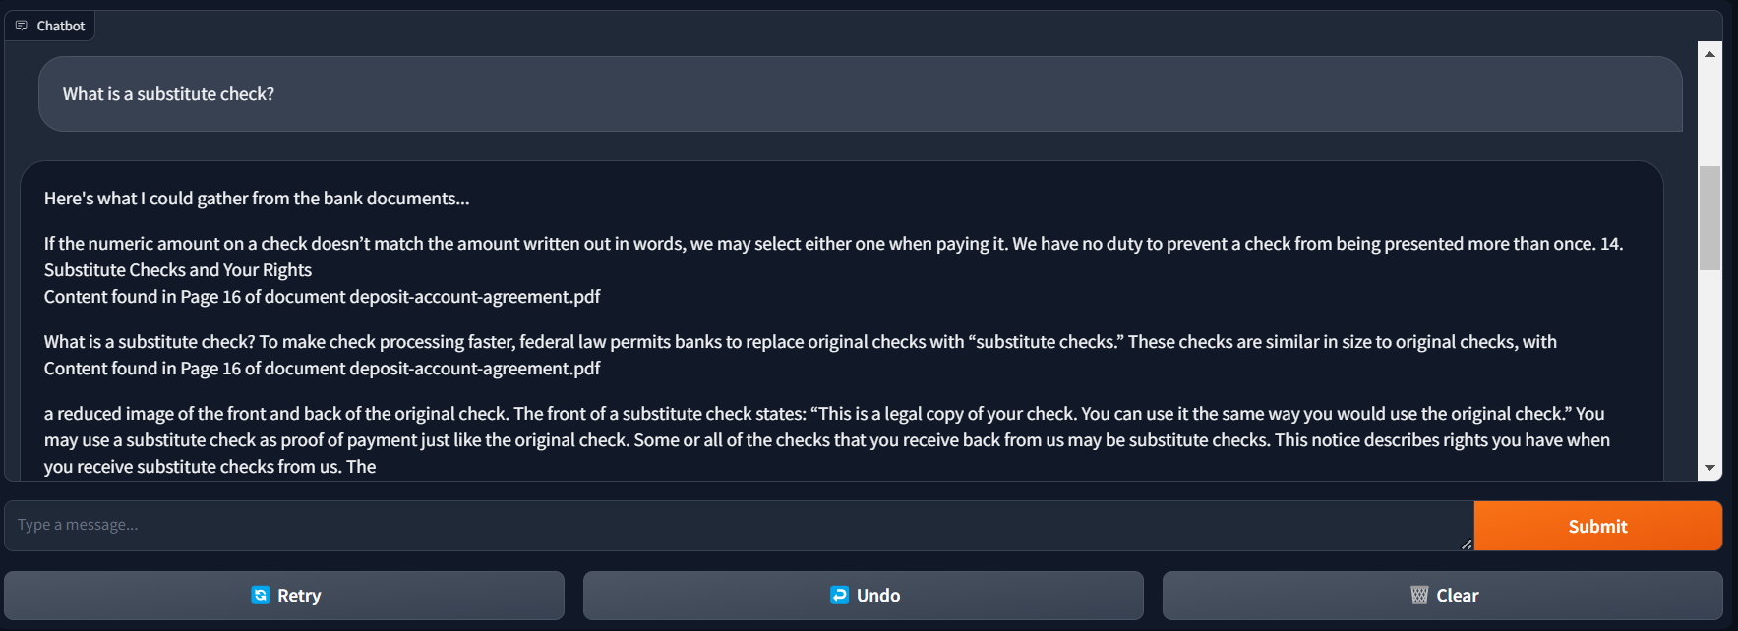
Scenario
(when the response is correct but comes in multiple lines and makes it hard to read)

Slide 16
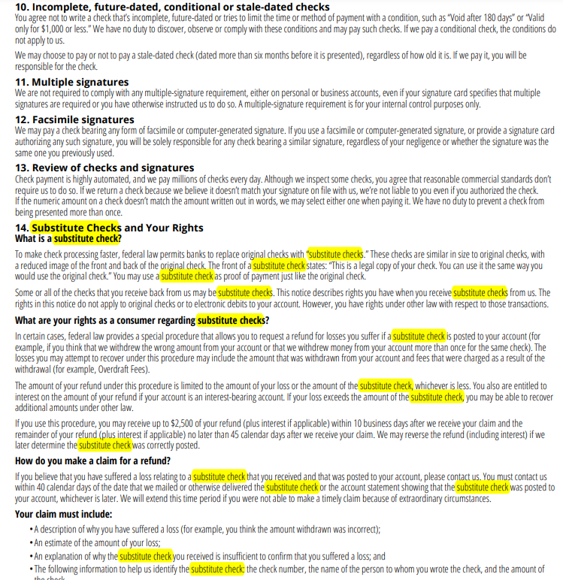
The Feature
A PDF with the region the user has questions about highlighted, in that specific document and page number.

Slide 17
Conclusion
NLP is a great alternative to Generative AI
Rule Based Chatbot - light computing, fast results
ChatBot + Highlight feature
Answers questions
Helps user get more information about topic
Better clarity

